Slide 1

GOLD DIGGER

Slide 2
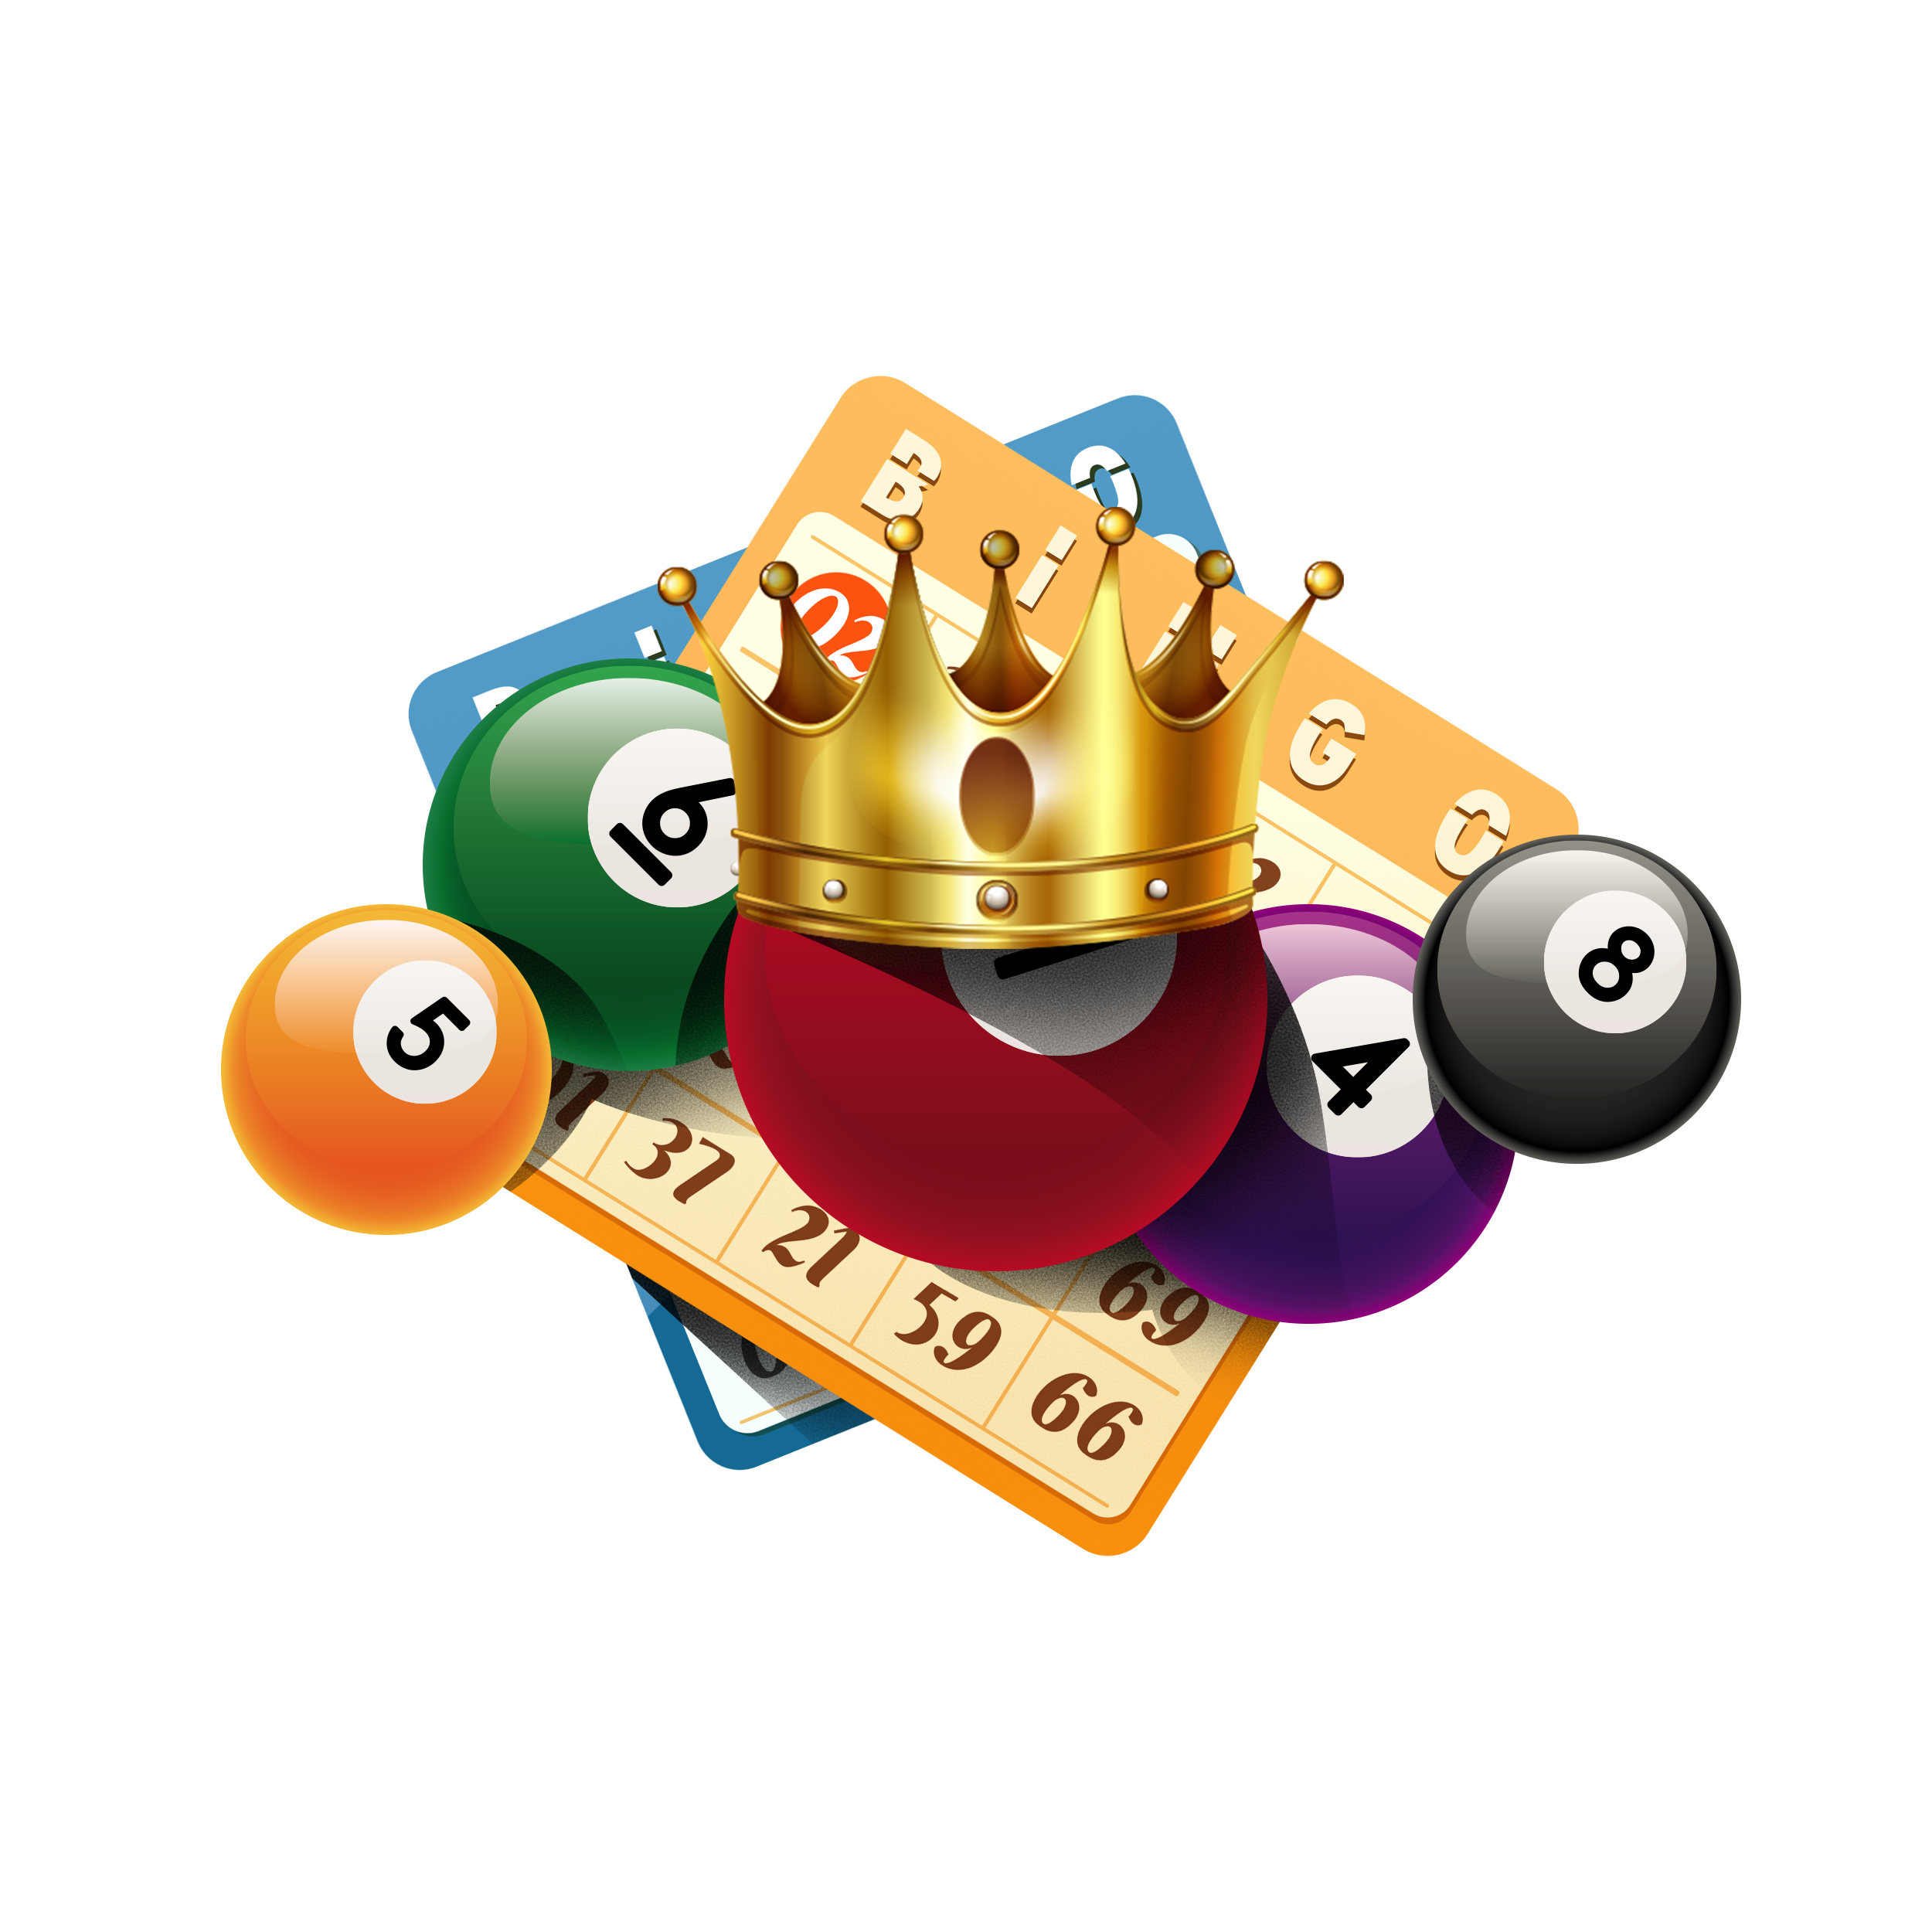
"Don’t work for money;
let your money work for you."
Made by: Deepak Barwal

Slide 3
Introducing GoldDigger:
GoldDigger is an innovative decentralized application (DApp) designed to bring the excitement of lotteries to the blockchain. It offers a secure, transparent, and fair platform for users to participate in a digital lottery, where every participant has a fair shot at winning.

Slide 4
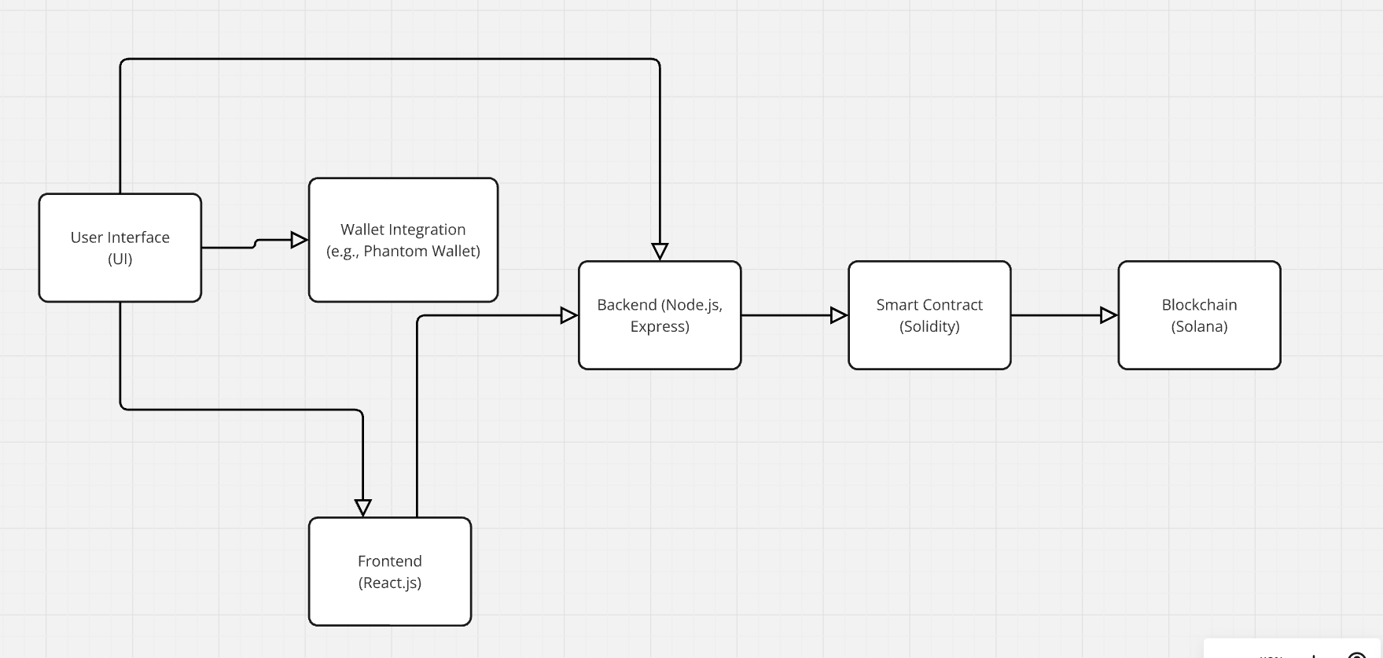
Architecture:

Slide 5
Problem:
Inefficiencies and Trust Issues in Traditional Lottery Systems

Slide 6
Lack of Transparency: The process of drawing winners is often opaque, leading to concerns about fairness and legitimacy.
High Operating Costs: Centralized systems involve significant overhead for administration, ticket sales, and prize distribution.
Limited Reach and Accessibility: Traditional lotteries can be restricted by geographical location and regulatory barriers, reducing potential customer base.
Trust Issues: Participants may doubt the integrity of the lottery process and the security of their funds.

Slide 7
Solution And Benefits:
Unmatched Transparency: All lottery draws and transactions are recorded on a public blockchain, so everyone can see and verify that everything is fair and above board.
Cost Efficiency: By using smart contracts to automate the lottery process, GoldDigger cuts down on administrative costs and middlemen. This means more of the money goes to the winners.

Slide 8
Global Accessibility: GoldDigger makes it easy for people all over the world to join in. It breaks down the barriers that limit traditional lotteries, allowing a wider audience to participate.
Enhanced Security: Blockchain technology ensures that all transactions are secure and that user data is protected. Smart contracts handle the details automatically, reducing the risk of fraud.

Slide 9
Features :
Low Transaction Fees
Feature: Integration with Solana’s blockchain technology ensures minimal transaction costs.
Benefit: Reduces the cost of participation, making the lottery more affordable for users.
Fast Processing Speed
Feature: Solana’s high-performance network supports rapid transaction processing.
Benefit: Ensures quick and efficient lottery operations, minimizing delays in draw results and user transactions.

Slide 10
User-Friendly Interface
Feature: A simple and intuitive user interface for participating in the lottery.
Benefit: Makes it easy for users to buy tickets, view results, and manage their participation.
Automated Draws
Feature: Lottery draws are conducted automatically through smart contracts.
Benefit: Eliminates human error and bias, providing a consistent and reliable draw process.

Slide 11
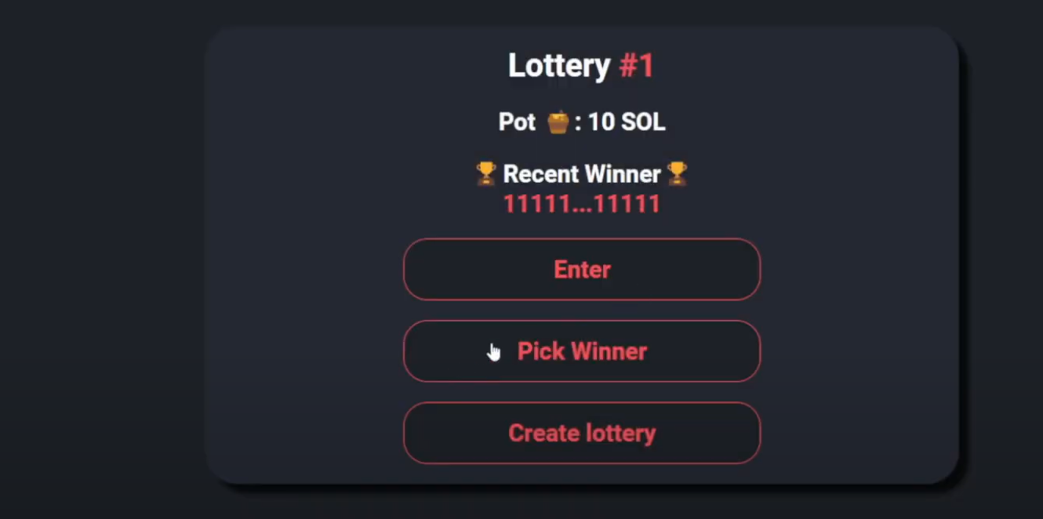

Slide 12
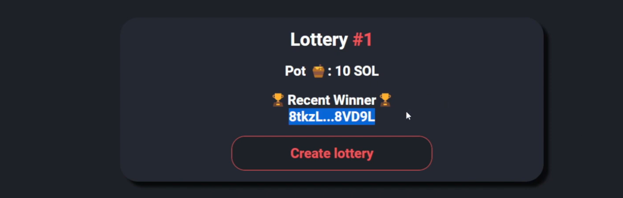

Slide 13
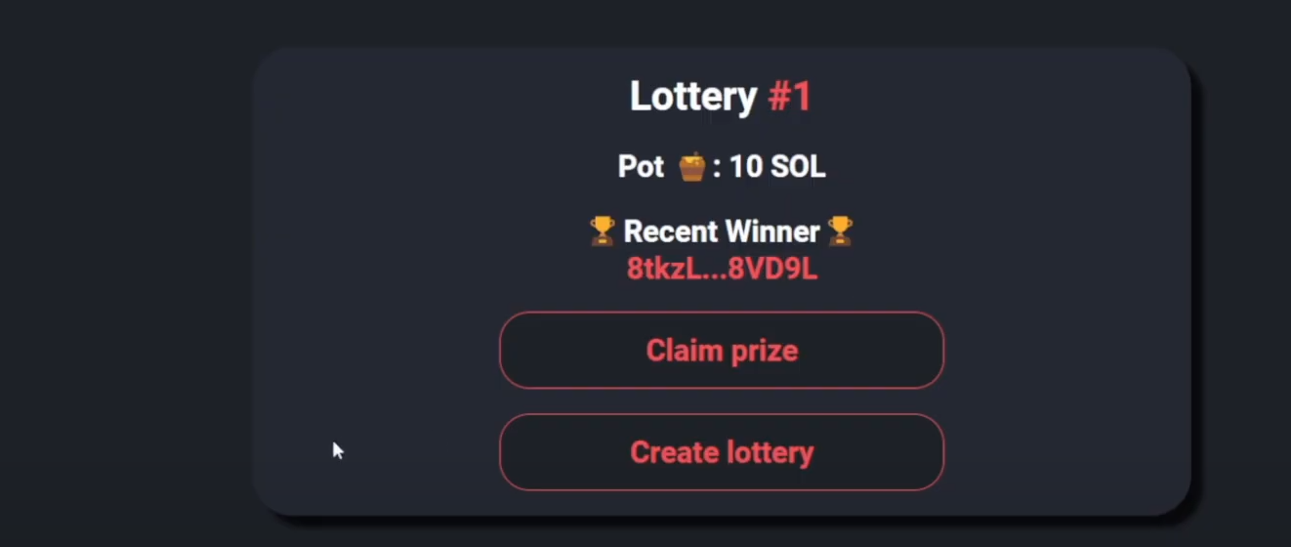

Slide 14
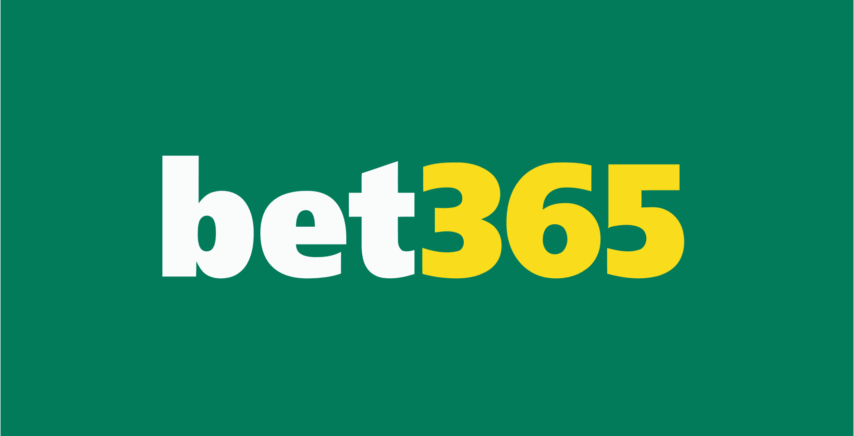

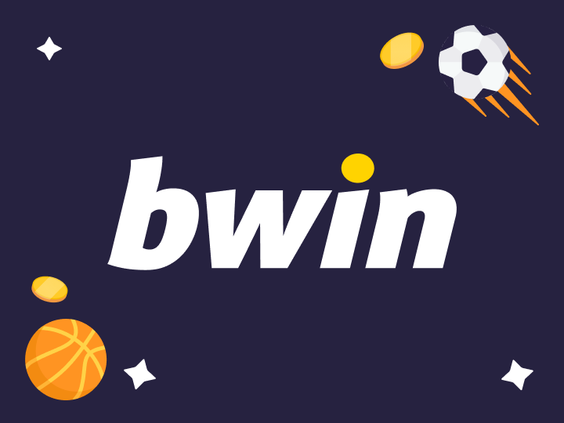
Competitors :

Slide 15



